Slide 1
PnP Community Information –May 2015 SSUG Gothenburg
aka.ms/OfficeDevPnP
aka.ms/OfficeDevPnPYammer
Patrik Björklund @pbjorklund

Slide 2


Me
Patrik Björklund
Office 365/SharePoint Consultant
@pbjorklund / patrik@cognit.se
blog.cognit.se
Notes:
Long time contributor to PnP
Find me online

Slide 3


Transform your code Providing App Model Patterns for common Full Trust Code scenarios
100+ Visual Studio projects Common scenarios
Branding
Site provisioning
Remote event receivers
Large file support
Taxonomy driven navigation
And much more…
Contribute
This is open source project and open for contirbutions
Developer
Patterns & Practices
aka.ms/OfficeDevPnP
Notes:
PnP started as a library of reusable code in an internal MS project. JDP (Joint Development Program), where MCS people shared code to be reused between their customers.
Turned into Office AMS.
Turned into PnP.
Provides guidance on how to transition from FTC to the app model and how to solve common scenarios in an App Model world (o365 apps are making their way into the project as we speak).
On top of this it also aims to make development on O365 a better experience.
Core team consists of a group of Microsoft employees along with a few community members with Vesa Juvonen at the helm.
Core team does this in their free time, the same as the rest of the community.

Slide 4
The PnP Repository
https://github.com/OfficeDev/PnP

Slide 5
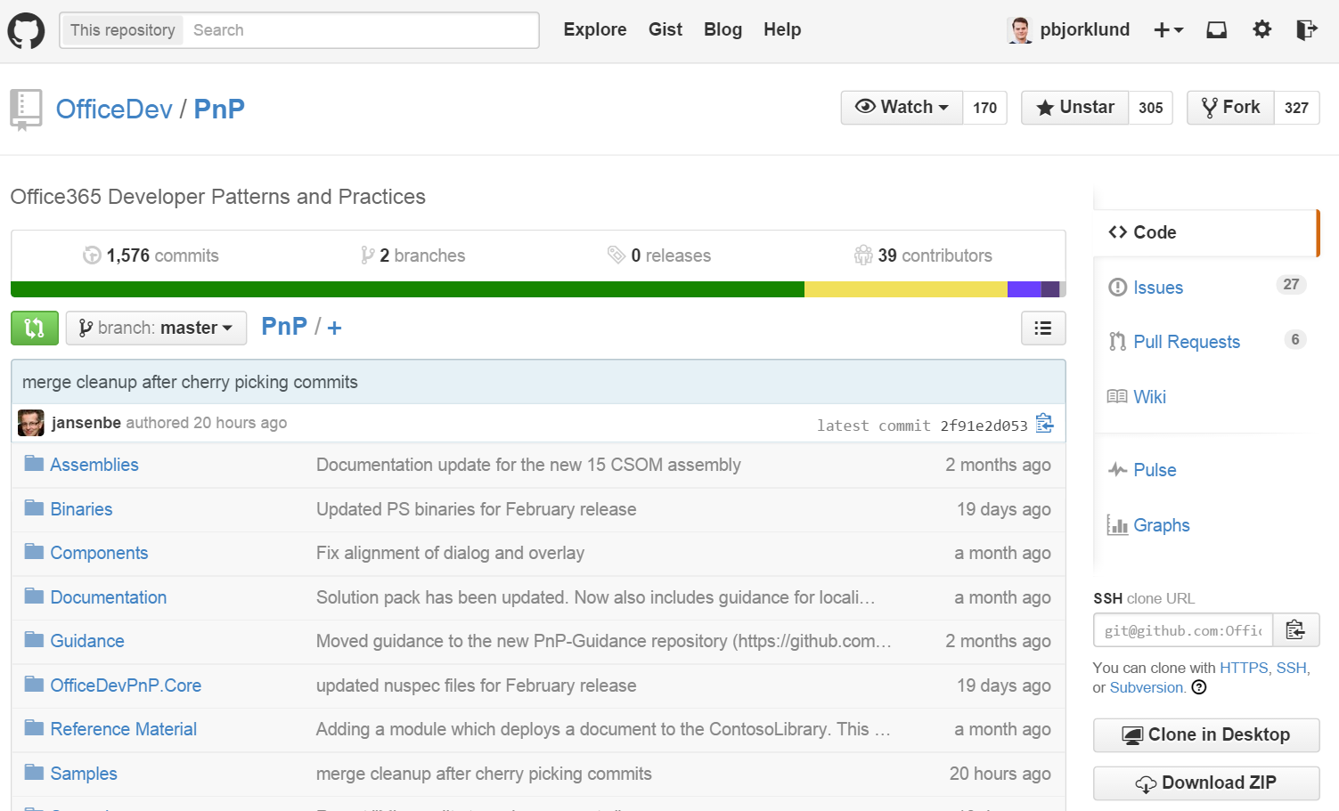
PnP Repo
Issues – File one or solve one
Pull requests – Contribute
Wiki – Learn, read
If you refuse to learn Git
Notes:
GitHub – MS moving more and more to GitHub.
Name implies git. Can use github for windows, git in visual studio or git on the command line.
I prefer command line.
Issues – you all know
PR – fix something/add something
Wiki – Learn about the PnP project, how to get started, community call schedule, etc
Master merge first Friday of the month

Slide 6
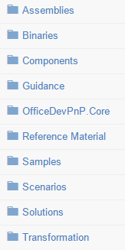
PnP Structure – folders and code
All referenced assemblies are included in package.
Contains latest 15 & 16 versions of the CSOM components.
No need for additional downloads
Reusable components targeted for reuse as such in projects.
Reusable remote operation component with extensions methods to standard CSOM objects.
PowerShell CMDlets installer
Sample projects. Independent samples demonstrating a capability or functionality.
Real life full trust solution mock-up for FTC to app model transition testing and verification.
Scenario demonstrations for the usage of the core component. Contains additional explanations and usage models for API patterns.
Complex reusable solutions demonstrating combining multiple capabilities for building real solution. Uses core component.
This folder contains tools and scripts that are used to help with transforming deployed FTC elements to it's app model counterparts. (Empty)
Notes:
Walk through the dirs. Show a few examples after this.
Assemblies: Latest 15/16
Binaries: PS installer
Components: standalone components, easy to integrate into apps
Core: extension methods. Will show later.
Reference: Old FTC solution to use in training, demos for FTC-> cloud
Samples: Small demo proj to show how to solve common problems. Not dependant on Core
Scenarios: Shows how the Core library can be used
Solutions: Shows more complex solutions.
Transformation: Empty folder right now. Will be interesting in the future. Transformation of FTC code

Slide 7
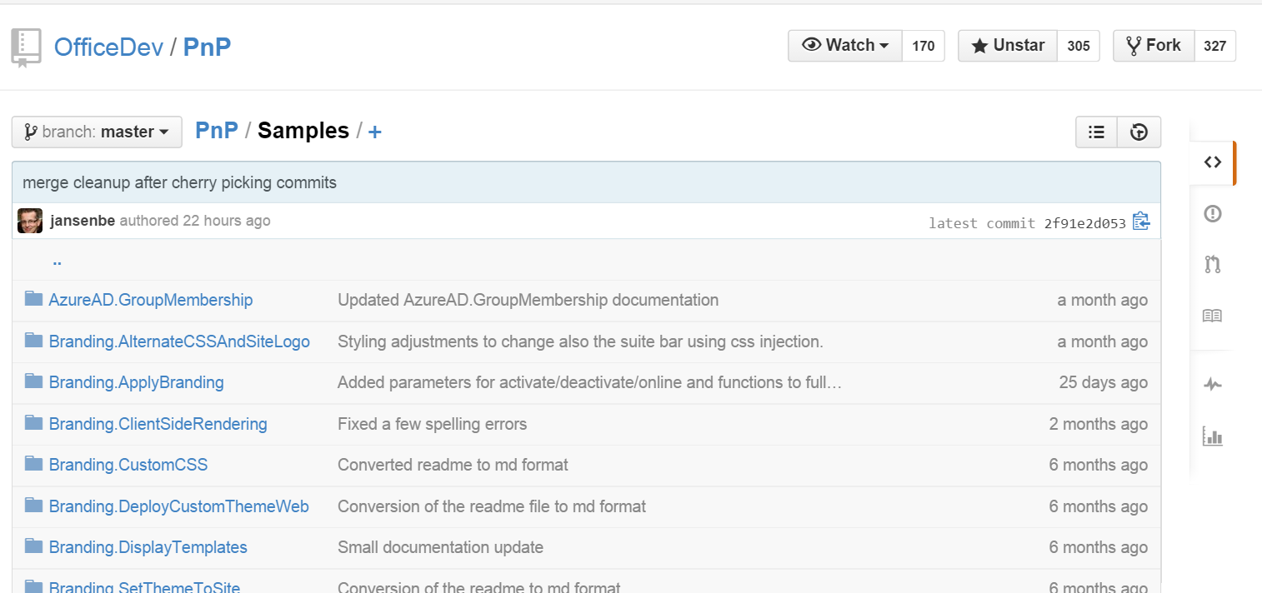
PnP Samples
[… A lot more]
Notes:
Small demo proj to show how to solve common problems. Not dependant on Core
Branding.SetThemeToSite – Apply theme to site
Branding.DisplayTemplats – Mobile friendly display template in CSWP
Cure.BulkUserProfileUpdater – Bulk update from CSV, extract from LDAP with auth
Core.LargeFileUpload – Upload large files
Core.PermissionsListing – Pull permissions from sitecollection
Also demos Workflows, Provisioning, Search, OfficeGraph, Office 365 apis etc

Slide 8
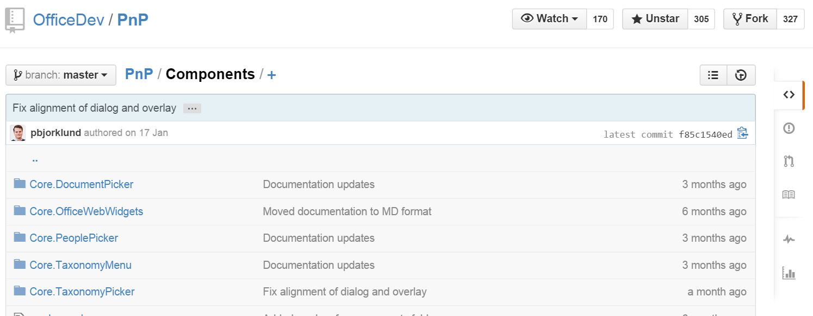
PnP – Components
Notes:
Components: standalone components, easy to integrate into apps

Slide 9
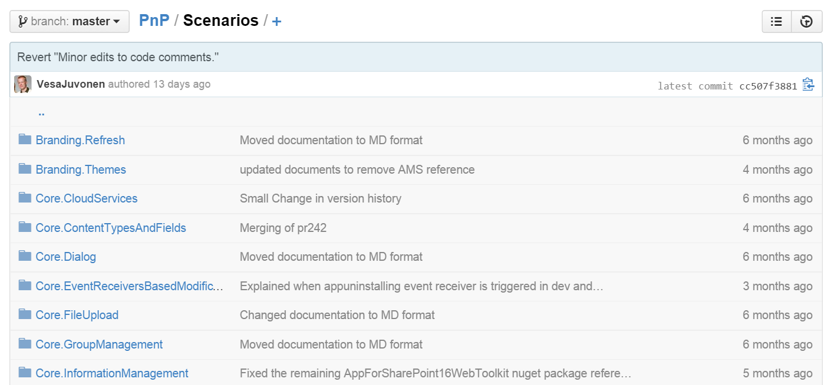
PnP – Scenarios
[…]
Notes:
Scenarios: Shows how the Core library can be used
Core.Dialog – Shows how to show an app inside a dialog
Core.FileUpload – Upload large file from within sharepoint app
ECM.AutoTagging

Slide 10
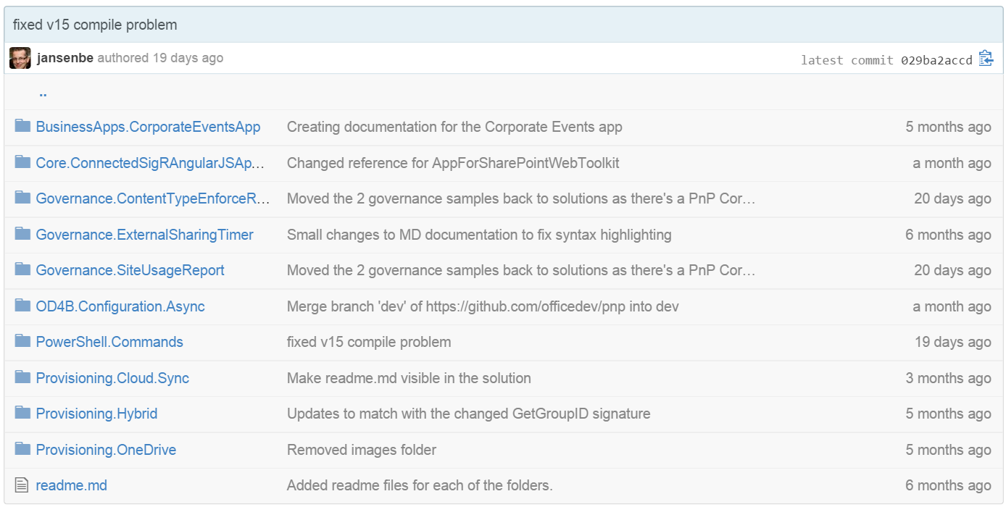
PnP – Solutions
Notes:
Solutions: Shows more complex solutions.

Slide 11
OfficeDevPnP.Core
Notes:
Extension methods to make life easier, framework

Slide 12
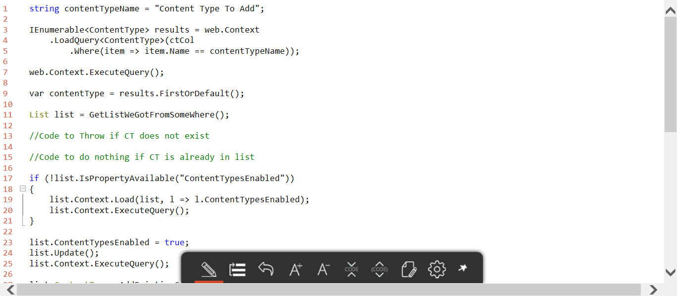
PnP – (Add CT to List w/o OfficeDevPnP.Core)
Notes:
Makes life easier.
Here we have (almost all) code required to add a contenttype to a list in a proper way

Slide 13
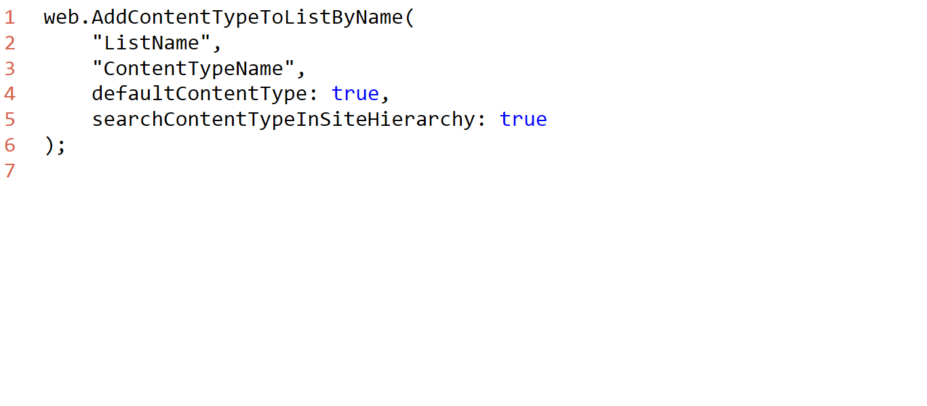
PnP – (Add CT to List w OfficeDevPnP.Core)
Notes:
This illustrates the core problem that Core started to solve. Eliminating error-prone boilerplate and tedious code.

Slide 14
OfficeDevPnP.Core.Provisioning
Notes:
TODO: What is the provisioning framework? Let’s build a small application that uses the provisioning framework! Console application
Create project
Add NuGet package
Prompt for credentials Show plain teamsite Show modified teamsite we want to clone
ProvisioningTemplate webTemplate = web.GetProvisioningTemplate(); newWeb.ApplyProvisioningTemplate(webTemplate); Reload plain teamsite
Profit

Slide 15
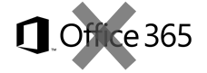
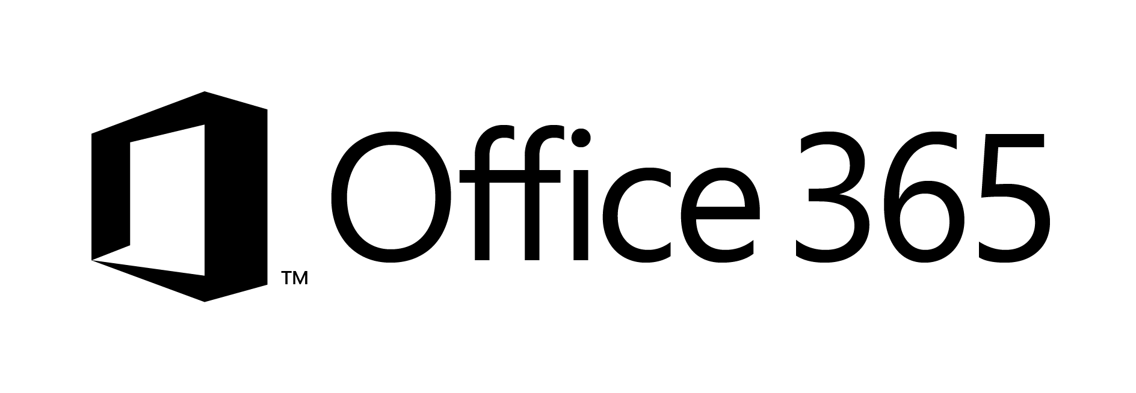

Site Provisioning Options/Comparison
Site Definition
Site Templates
Web Templates
SP Server side provisioning
Remote provisioning
No Office365
Long term impact on costs
Blocks transition to cloud
Causes significant issues with future migration and upgrade
Poor site collection creation story
Negative impact on upgrades
Causes additional maintenance costs with evergreen
Not with publishing features
Poor site collection creation story
Causes maintenance costs with evergreen
Provision oob sites, but modify them based on user selection and requirements
Standardization of site creation in code
No Office365
CSOM supports creation of site collections only in Office365
Standardization of site creation in code
Can be done from any external system
Options
Support in cloud
Options available
Poor
Fair
Average
Good
Excellent
Cost impact (short and long term)
Notes:
For more information on provisioning sites and associated terminology see:
SharePoint 2010 and web templates, http://blogs.msdn.com/b/vesku/archive/2010/10/14/sharepoint-2010-and-web-templates.aspx
Site provisioning techniques and remote provisioning in SharePoint 2013, http://blogs.msdn.com/b/vesku/archive/2013/08/23/site-provisioning-techniques-and-remote-provisioning-in-sharepoint-2013.aspx

Slide 16

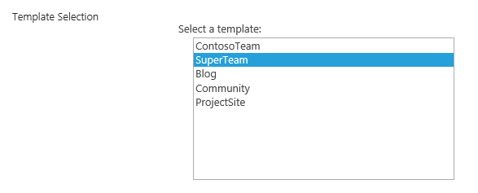

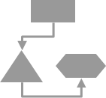
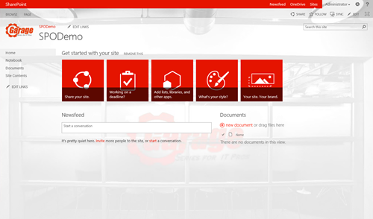

Async site collection/web provisioning
Azure ServiceBus
CSOM/REST
C#
Assets and configuration
Remote Timer job
Branding Images
Master Pages
Page Layouts
Other settings
Notes:
One way to do provisioning

Slide 17
OfficeDevPnP.Core.Provisioning Demo
Notes:
The PnP project now comes with it’s own provisioning engine, built on top of a schema definition that we can look at later if we have time.
But enough talk, let’s look at a simple console application that uses the framework.
Let’s build a small application that uses the provisioning framework!

Slide 18
PnP - Added value

Slide 19
PnP Value - Architect
Microsoft sanctioned solutions for common scenarios
Thoroughly integration tested extensions
Monthly releases through NuGet
Save time and mental capacity
Notes:
MS sanctioned solutions to solve common problems/scenarios, can save a lot of development time. Thouroughly integration tested extensions with montly NuGet releases.
I check solutions/samples before google when not sure about the best approach. It has worked out really well in my previous 1 year long project.
Things from Core can trickle up into the CSOM api. SetSiteLogo turned up as web.SetSiteLogoUrl.
Deprecated when happens.
In future – Deprecation will state when deprecation will happen.
Keep it up to date

Slide 20
PnP Value - Developer
Core - Less boilerplate, DRY, trust the code quality
Opportunity to contribute back to the community
Notes:
Core - Write less boilerplate code. Trust the code that is written
Opportunity to share fixes back to the community (note: needs customer approval).
DRY / Don’t' reinvent the wheel. Focus on building solutions that provide value

Slide 21
PnP Value - Business
Save money. Sometimes a lot of money
Best practice
Notes:
PnP can save you a lot of money. This is where a lot of the best practices are formed

Slide 22
PnP Value – End User
Common Experience across domains and projects
Shorter time to market -> shorter time to solution
Notes:
Relying first on PnP components can give a common experience across domains and projects, no matter the development team. *if PnP is recommended by the business

Slide 23
Getting involved

Slide 24
PnP Repo Statistics
Forked 603 times
641 merged pull requests
140 closed issues
More than 4000 unique visitors during last 2 weeks
Nuget package 6423 downloads
Yammer group has 2521 members
aka.ms/OfficeDevPnPYammer
Notes:
More forks than the Azure .NET SDK

Slide 25
How to contribute?
Documentation in wiki
https://github.com/OfficeDev/PnP/wiki/contributing-to-Office-365-developer-patterns-and-practices
Simple steps
Fork
Apply changes and contributions
Submit a pull request
Core team members will review
Merged to Dev
Notes:
http://www.git-scm.com/book/en/v2

Slide 26
Community calls
Vesa talks a lot, the rest of the hour is demos and questions
Monthly call on 2nd Tuesday on each month @ 17:00
Lync link in PnP wiki
Notes:
Calls are “muted” no-one has to talk. Talking is optional in last part

Slide 27

Roadmap – What’s coming?
Starter kits
Provisioning
Remote timer jobs
Improvements to core component
Unit testing, logging, other stuff
Guidance
Application Life Cycle for app model
Design patterns for App model based implementation
Transformation guidance for existing customizations
App model impact for enterprise architecture
Content migration for app model implementation
Continuous integration

Slide 28
Feedback…
Please keep the feedback coming in Yammer… we need your input for the prioritization.
Yammer group O365 Dev Patterns & Practices @ yammer.com/itpronetwork/
Notes:
Priority on planned topics
More code samples
Add core component capabilities
Reusable presentation material
Documentation on patterns and practices for app model (ALM ec.)
More complex solutions
More Office Client apps
More JavaScript app
Length: 30 second for this slide
Instructor notes
The following slides will walk you though the Lync tools that we will use in this class.
You will use all of these tools later in the class
Stress that your students will be able to run much more engaging meetings if they use these tools in their own Lync Meetings.
Course Development Notes:

Slide 29

Questions?

